Slide 1
Lecture 6. Concepts of Ad-Hoc Networks (07/12)
Introduction of Wireless Networking
1. Mobile Ad-Hoc Networks
2, Introduction
3. On-Demand Routing
4. Mobile Host Registrations procedure
5. Routing in Mobile Ad Hoc Networks
6. Mobile Ad Hoc Networking

Slide 2

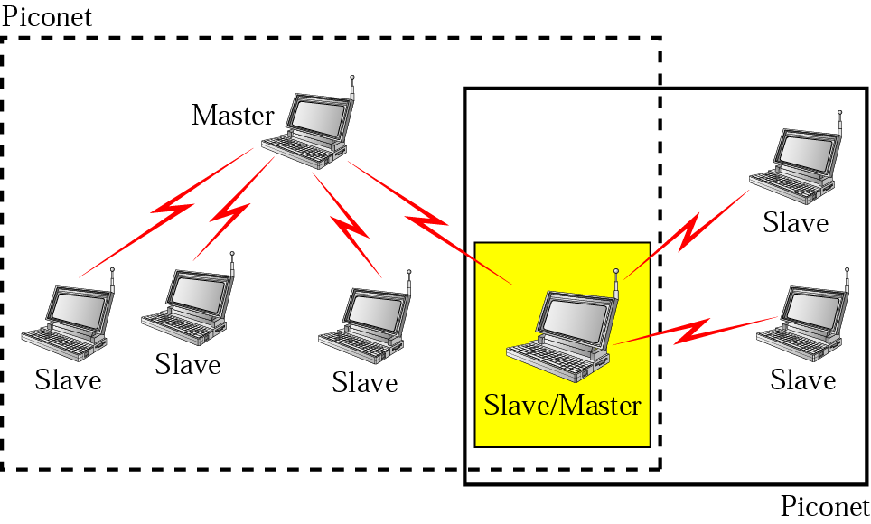
1. Introduction to Mobile Ad-Hoc Networks (MANET)
Roaming routers and hosts
a. 802.11
b. 802.15

Slide 3
Mobile Ad-Hoc (MANET) Network features
A-H
  Infrastructureless, no BS support
  Wireless multihop connection
  Limited resources: bandwidth, energy supply, memory.
Extend network access to unreachable areas. MANET extends mobility into unreachable area by set of nodes, which may be combined routers and hosts, they form the network routing in an Ad-Hoc fashion.
Applications: digital battlefields, sensors, disaster recovery, law enforcement, conventions, etc.
Notes:
Ad hoc networks are attractive because they are able to provide seamless information access at places that are not covered by any network infrastructures, either cellular system or Internet. And they are able to meet instant and emergent requirements. So the technologies of ad hoc networking are expected to play important roles in applications such as disaster recovery, wireless sensor networks, law enforcement, and so on.

Slide 4



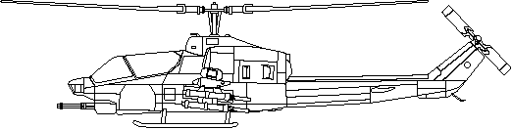

A-H
Single Hop (Cellular)
Base
Base
Base
Base
Multihop (Ad-Hoc)
! floor plan found
? floor plan

Slide 5
Notes:
Here is a scenario which demonstrates where ad hoc networks would be used and how the network would look like.
The picture illustrates a vision of the Minuteman project, an ONR founded research for automated battlefields.
In this scenario there are several mobile agent teams. E.g. ground mobile troops and in the air, UAV missions.
These agent teams may appear to be localized in different sectors with different tasks, they are actually interlocking
components commanded by mission control located offshore on a manned control platform.
For example, the anticipated missions are close air support, surveillance, reconnaissance, and strike.
The principal objective of the vehicles is to enable time-critical over-the-horizon target detection, identification, tracking, and precision engagement where targets could be stationary or mobile and often in clutter environment.

Slide 6
Ad-Hoc Network Applications
Military
  Automated battlefield
Civilian
  Homeland defense
  Disaster Recovery (flood, fire, earthquakes etc)
  Law enforcement (crowd control)
  Search and rescue in remote areas
  Environment monitoring (sensors)
A-H

Slide 7
Ad-Hoc network implementations
A-H
Ad-hoc Nets can be implemented with different radio and MAC technologies:
Most common is 802.11 “ad-hoc mode”
Bluetooth 802.15 scatternets
Zigbee 802.15.4 trees and meshes

Slide 8
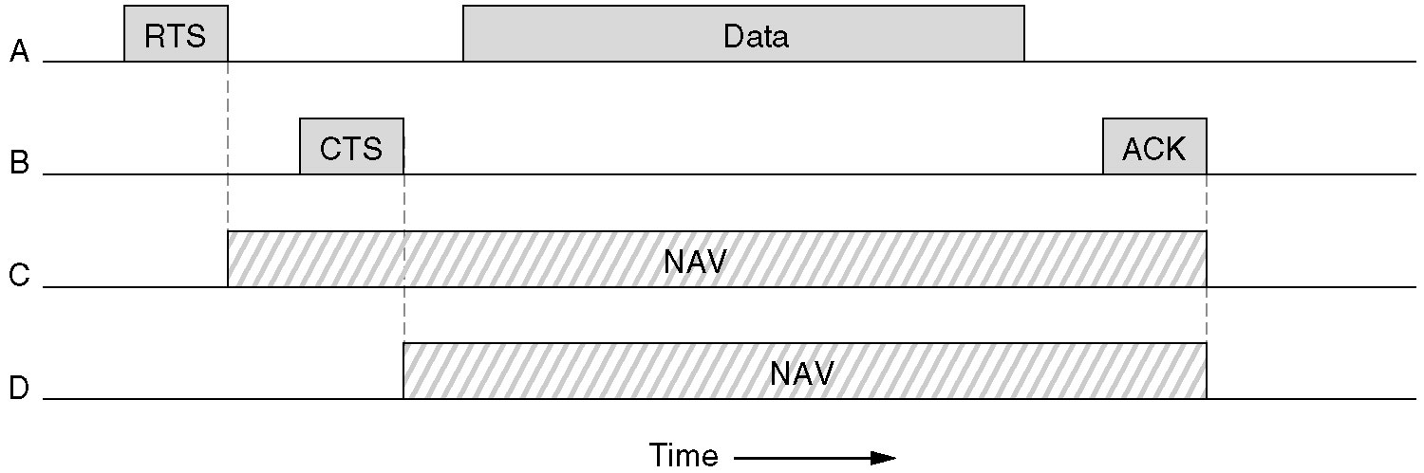
802.11 MAC (DCF)
802.15 Scatternets MAC (PCF)

Slide 9
MANETs characteristics:
A-H
MANET (Mobile Ad-Hoc Networks) nodes are equipped with wireless transmitters and receivers using antennas
1. Dynamic topologies: Nodes are free to move; thus, the network topology, is typically multihop, may change randomly and rapidly, and may consist of both bidirectional and unidirectional links.
2. Bandwidth-controlled, variable capacity links: Wireless links will continue to have lower capacity than their hardwired counterparts.
3. Limited physical security: MANETs are more prone to physical security than are fixed-cable nets.
4. Decentralized nature of network

Slide 10
A2. On-Demand Routing
Routes are established “on demand” as requested by the source
Only the active routes are maintained by each node
Two leading methods for route discovery: source routing and backward learning
For different applications of sending packets there are different routing algorithms:
Broadcasting, Multi-destination, Signaling tree, Reserve path forwarding algorithms.
A-H

Slide 11
Packet Routing Algorithms
The function of the network layer is routing of packets from the source machine to the destination machine. In most subnets, packets will require multiple hops to make the connectivity.
The algorithms that choose the routers and the data structures call the router algorithms.
Router have two processes inside it.
a. Forwarding: Looking up the outgoing line to use for it in the routing tables.
b. Updating: is responsible for filling in and updating the routing tables
Routing algorithm Properties:
correctness, simplicity, robustness, stability, equality, and optimality.
One of helpful statement is the Optimality principle
Routing algorithms: Nonadaptive and Adaptive.
Nonadaptive do not base their routing decision on measurements or estimates of the current traffic and topology.
Adaptive change their routing decisions to reflect changes in the topology.
A-H

Slide 12
Routing (example)
Full table for A; Hierarchical table for A
Region 1
Region 2
Dest. Line. Hop
1A -- --
1B 1B 1
1C 1C 1
2A 1B 2
2B 1B 3
2C 1B 3
2D 1B 4
3A 1C 3
3B 1C 2
4A 1C 3
4B 1C 4
4C 1C 4
5A 1C 4
5B 1C 5
5C 1B 5
5D 1C 6
1E 1C 5
Dest. Line. Hop
1A -- --
1B 1B 1
1C 1C 1
2 1B 2
3 1C 2
4 1C 3
1C 4
5 1B 5
1B
2A 2B
1A
2C 2D
1C
Region 3
Region 5
7 entries
B
C
(c)
3A
A
5
(Kleinrock)
N routers need e lnN entries
3B
4A
D
Region 4
E
A-H
4B 4C
17 entries
(a)
(b)
For different applications there are different routing algorithms: 1-Broadcasting, 2-Multidestination, 3-Signaling tree, 4-Reserve path forwarding.

Slide 13
The algorithm, in which the node A wants to send a packet to node I.
AH
Range of A’s
broadcasting
A
B
A
A
A
B
B
B
C
D
C
C
C
D
D
D
E
E
E
E
F
G
F
G
F
G
F
G
H
I
H
I
H
I
H
I
(a) (b) (c) (d)
(a) Range of A’s broadcast. (b) After B and D have received A’s broadcast. (c) after C, F, and G have received A’s broadcast. (d) After E, H, and I have received A’s broadcast.
The arrows show the possible reverse routes.

Slide 14
ROUTE REQUEST packet arrives at node B & D,
1.The a.Source address, b. Request ID pair is looked up in a local history table to see if this request has already been seen and processed.
2. If it is a duplicate, it is discarded and processing stops.
3. If it is not a duplicate, the pair a. & b. is entered into the history table so future duplicates can be rejected, and processing continues.
4. Receiver looks up the destination in its route table.
5. If a fresh route to the destination, a ROUTE REPLY packet is sent back to the source telling it how to get to the destination (“Use me”). Fresh means that the Destination sequence number (DSN) stored in the routing table is greater than or equal to the DSN in the ROUTE REQUEST packet. If less, the stored route is older than the previous route the source had for the destination, so step 3 is executed.

Slide 15
ROUTE REQUEST packet
AH
Source Request Destination Source Dest. Hop
Address ID address sequence # sequence # count
0
1
3
2
ROUTE REPLY packet
4
Source Destination Destination Hop Lifetime
Address address sequence # count
5

Slide 16
Data Forwarding
A-H
After group establishment and route construction process, a multicast source can transmit packets to receivers via selected routes and Forwarding Groups.

